Slide 1


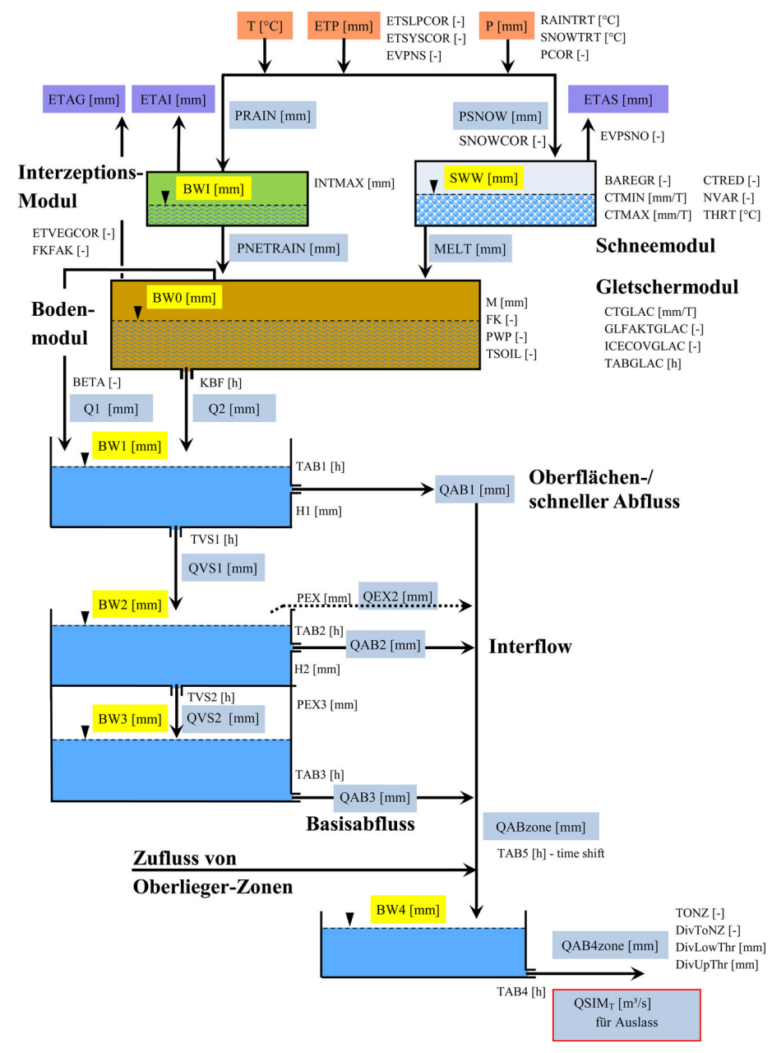
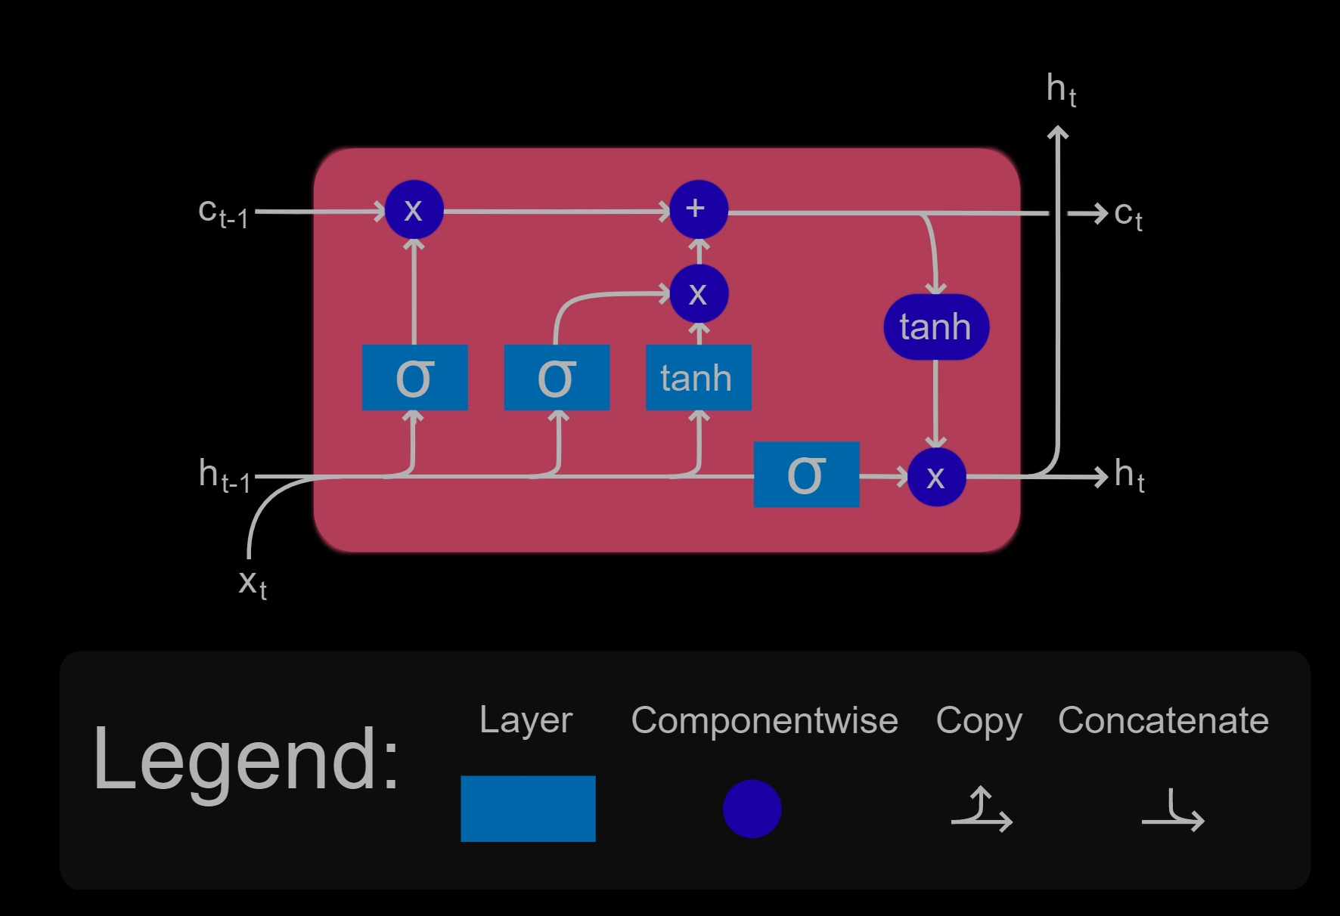
ML for Earth & Env Sci (Chapter 7, FA2025)
How can we make accurate predictions from sequences?
?
Source: Wesemann et al. (2018), Wikipedia (LSTM)
Notes:
COSERO hydrological model

Slide 2
Min 15-35: Recurrent Neural Networks & Convolutional NNs to Process Sequences
Learning Objectives (Géron Ch15 & Ch16):
Define a recurrent neural network
Distinguish recurrent from convolutional neural networks
Discuss the forecasting of environmental time series
Know at least three algorithms to process time-series

Slide 3
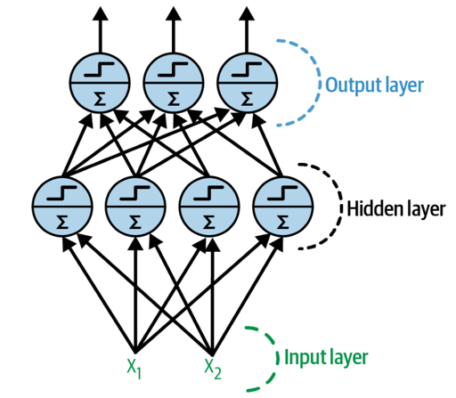
3 weeks ago = General case: Artificial Neural Networks
Notes:
1 layer = similar to logistic regression
2 layers = shallow neural network
Deep learning = 3 layers and above
VOTE 1: How many trainable parameters (weights and biases) in the input layer?
VOTE 2: If the input layer was a 10x10 image, how many trainable parameters?

Slide 4


2 weeks ago = Convolutional Neural Networks (CNNs)
Regularized versions of Artificial Neural Networks used to process images
Source: Giphy, Analytics India Magazine (K. Maladkar)

Slide 5
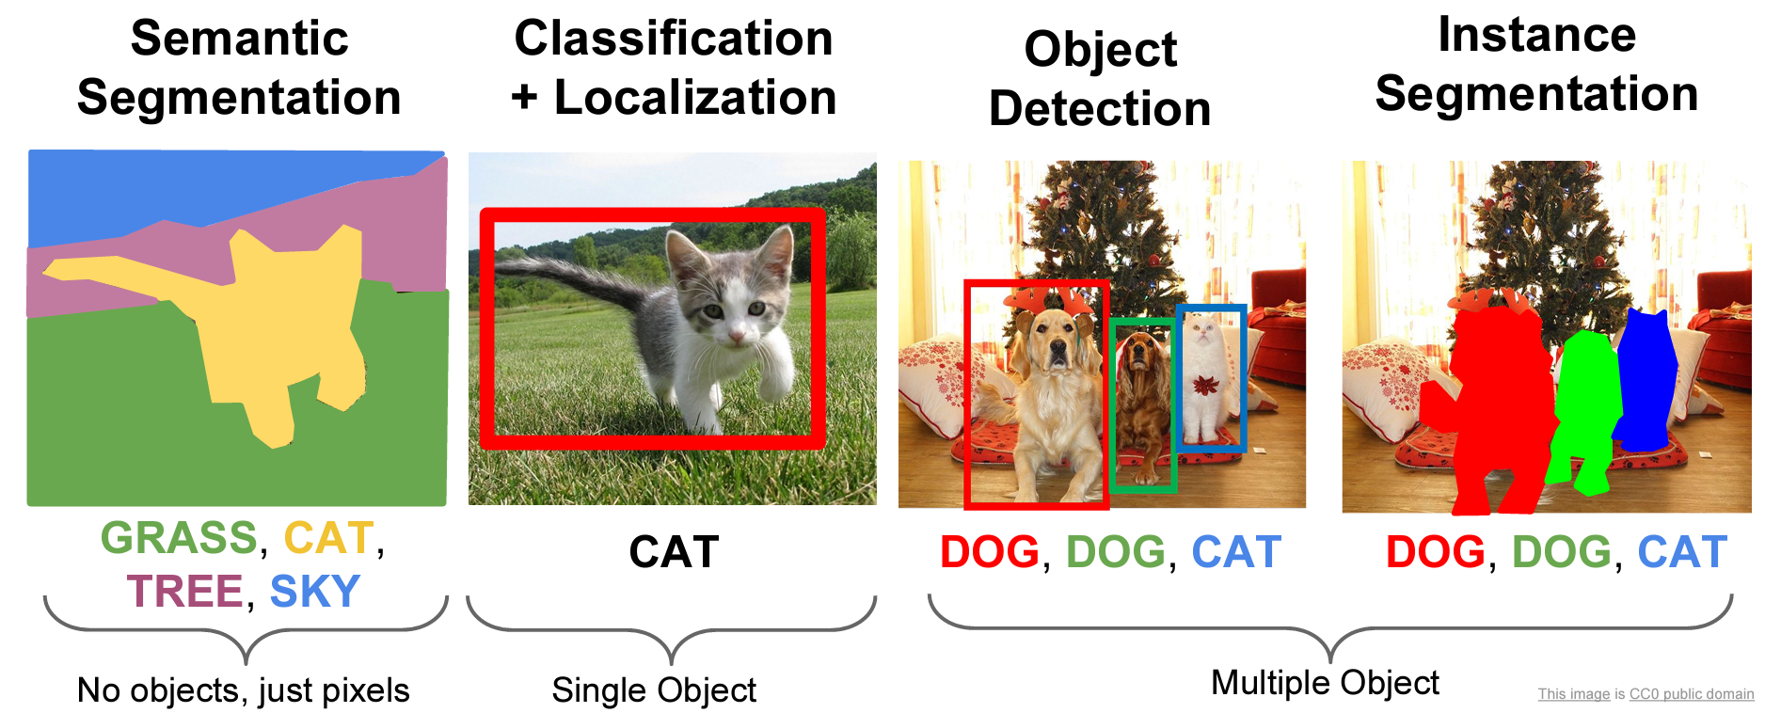
CNNs used for computer vision (analyzing images, videos)
Source: Stanford (CS231)

Slide 6
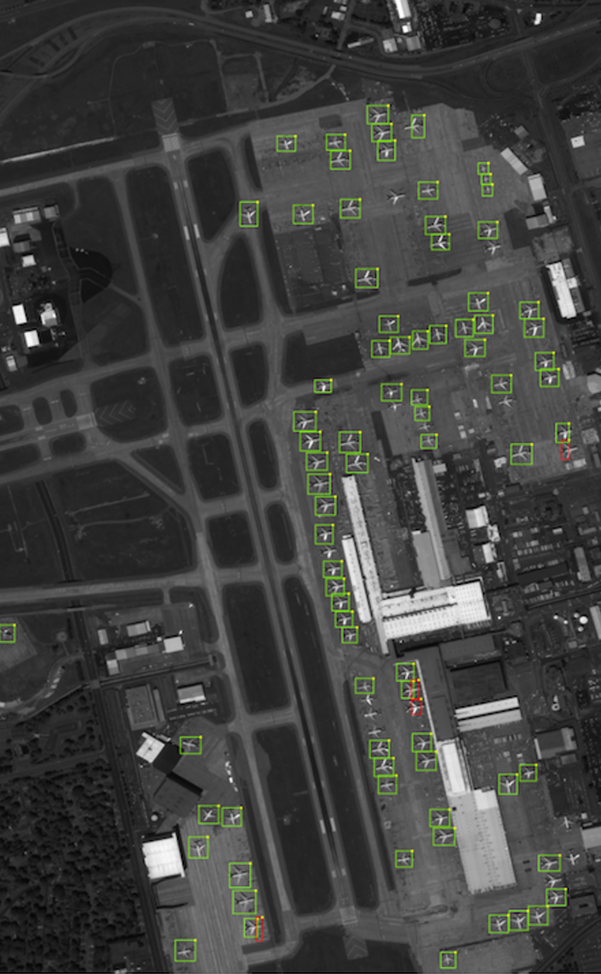
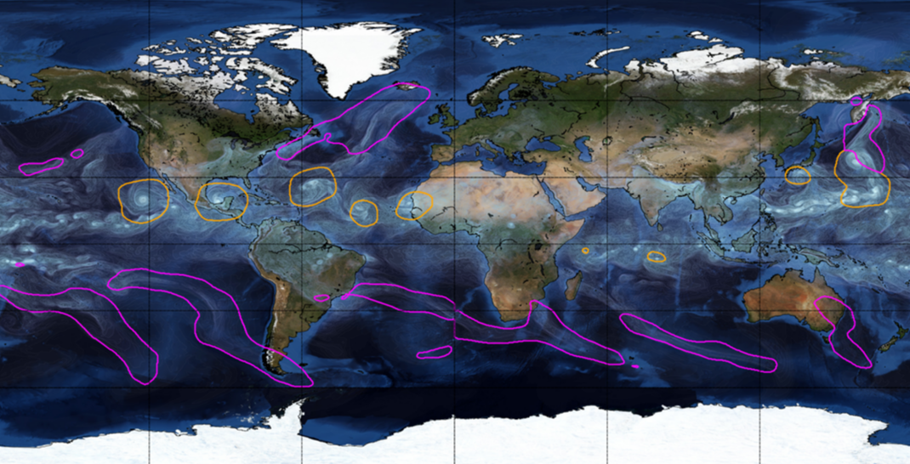
Object Detection for Remote Sensing
Instance Segmentation for Storm Detection
Source: Zhu et al. (2017), Prabhat et al. (2020)

Slide 7

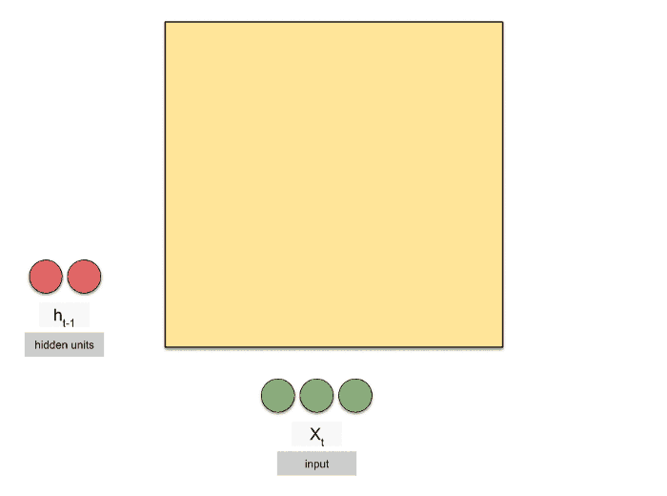
This week: Recurrent Neural Networks (RNNs)
Regularized versions of ANNs to process sequences
Source: Michael Phi, Raimi Karim (Towards Data Science)

Slide 8
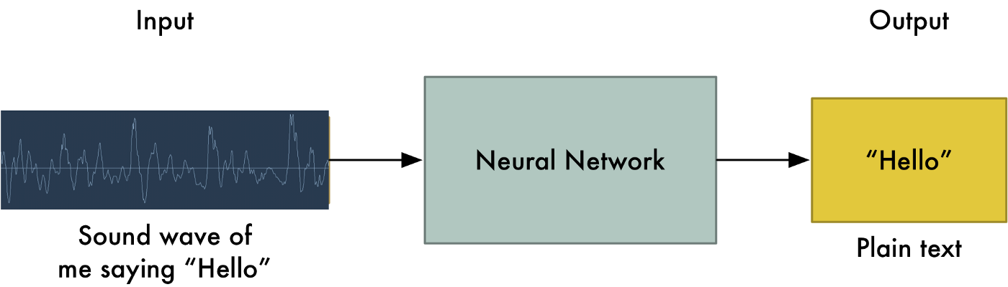
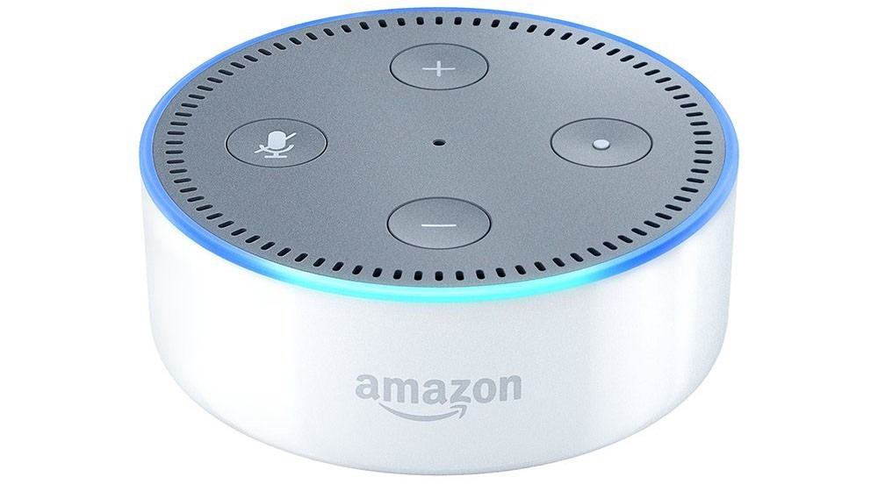
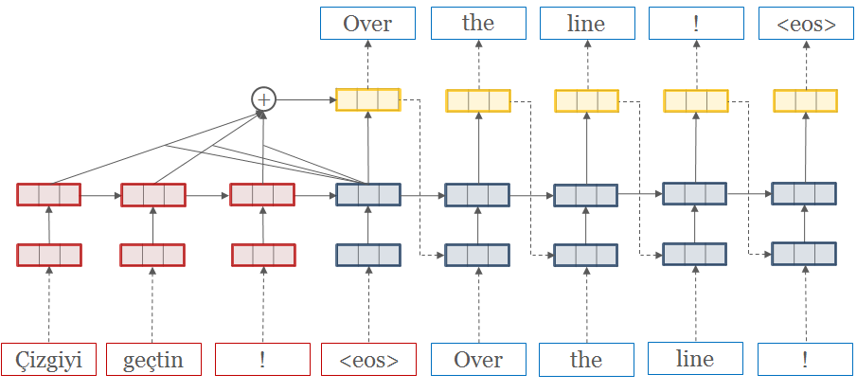
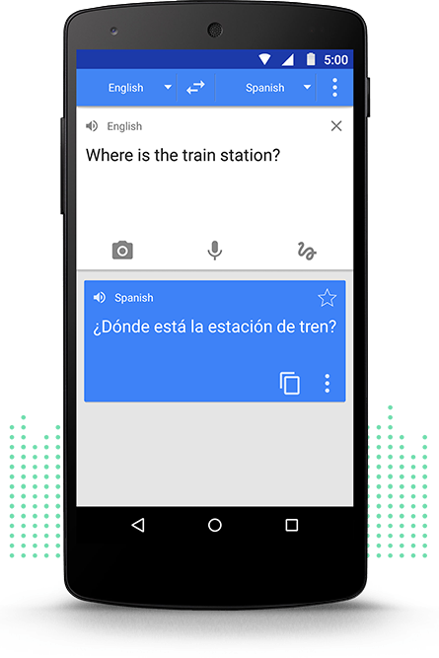
RNNs used to process sequences
Speech Recognition
Machine Translation
Source: Adam Geitgey (Medium), opennmt.net, Google Translate

Slide 9
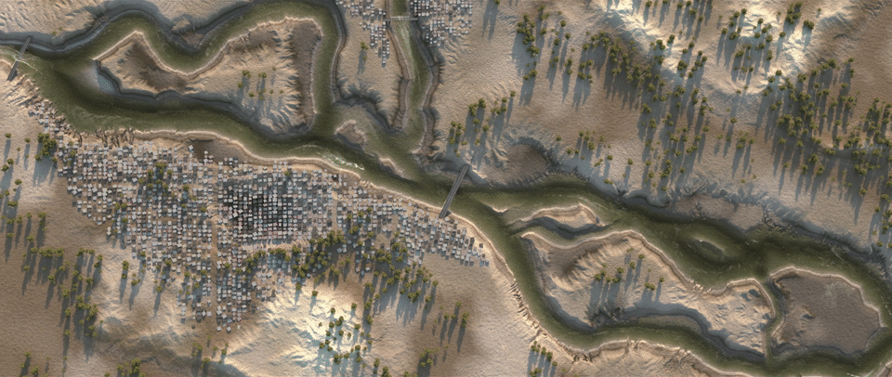
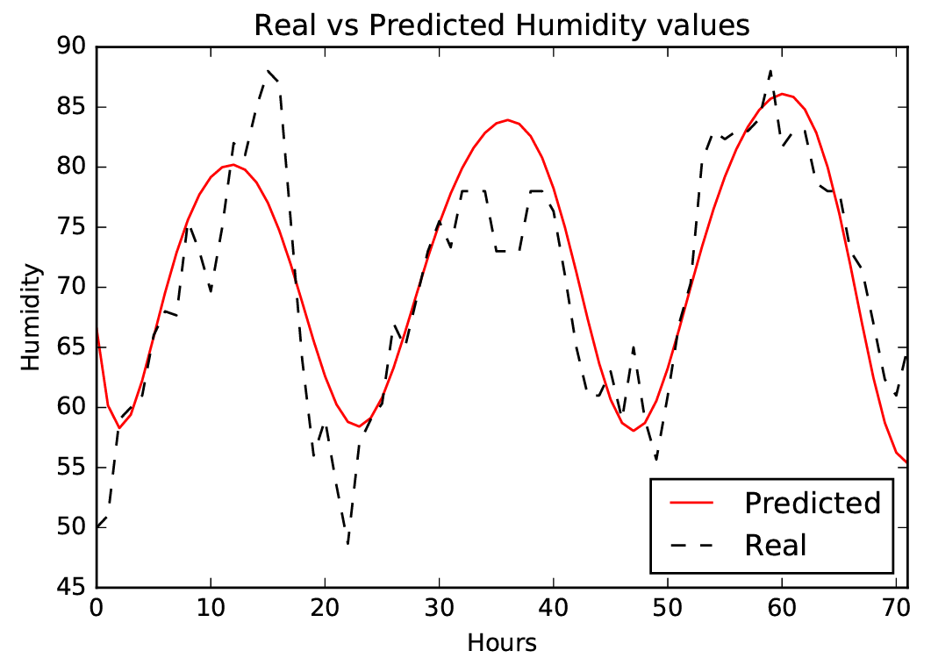
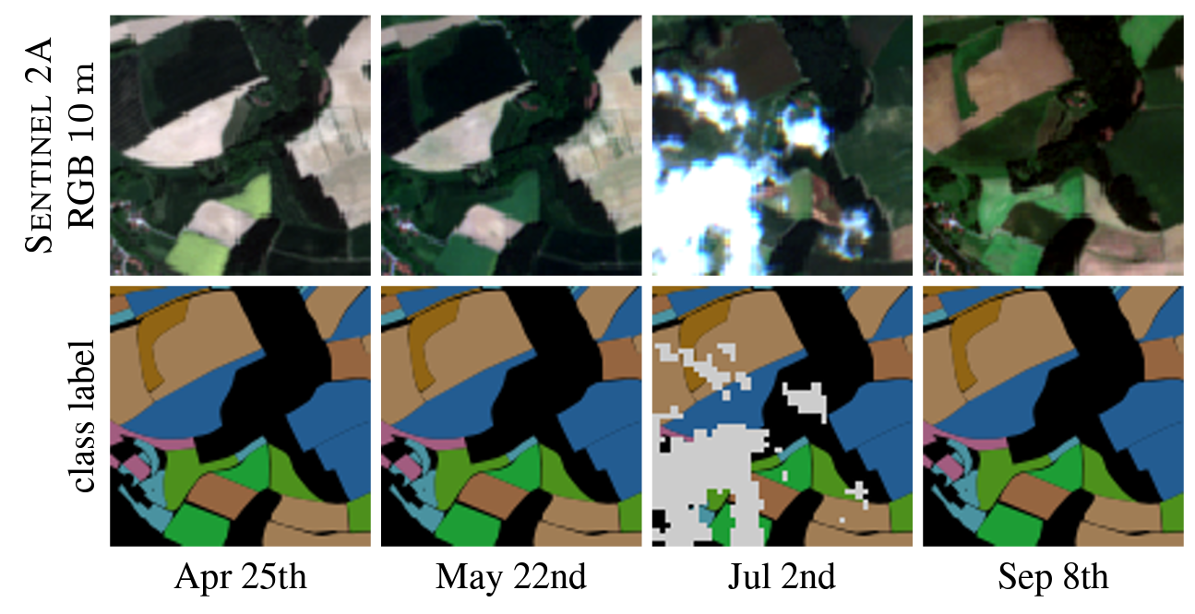
Catchment-independent rainfall-runoff models
Dynamic Time-Series Modeling
Dynamic Land Cover Classification
Source: Nadav Peleg (UNIL), Zaytar and El Amrani (2016), Russwurm et al. (2017)

Slide 10
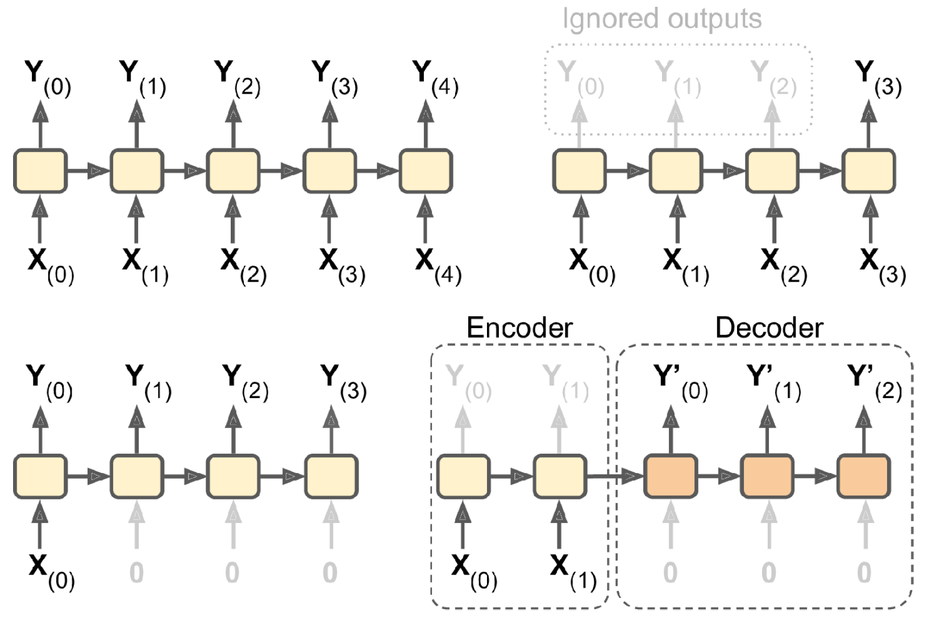
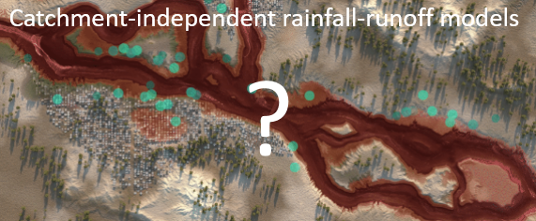
Forecasting Time-Series in Environmental Science
Seq-to-seq:
Env. Time Series Prediction
Seq-to-vector:
Make a single prediction
Encoder-dec:
Predicting time series of related but different vars
Vector-to-seq:
Predicting time series from 1 observ.

Slide 11
Why is naive forecasting (persistence forecast) so hard to outperform?
Notes:
Source : Water Quality Prediction in the Luan River Based on 1-DRCNN and BiGRU Hybrid Neural Network Model

Slide 12
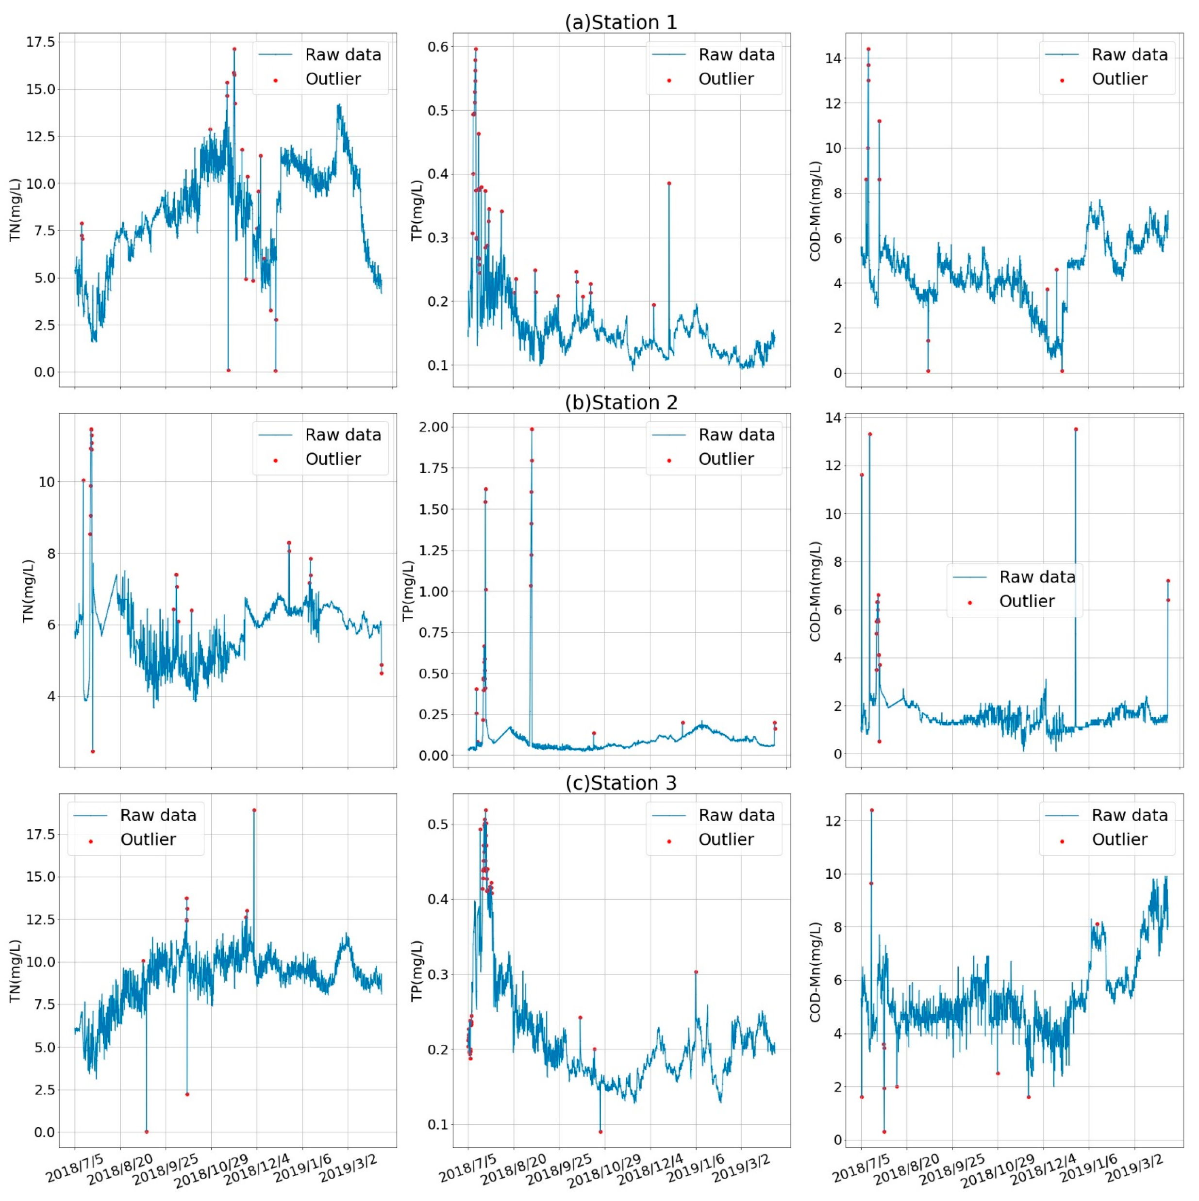
Why is naive forecasting (persistence forecast) so hard to outperform? Autocorrelation in time
Source: Zaytar and El Amrani (2016), Yan et al. (2021)
Notes:
Source : Water Quality Prediction in the Luan River Based on 1-DRCNN and BiGRU Hybrid Neural Network Model

Slide 13
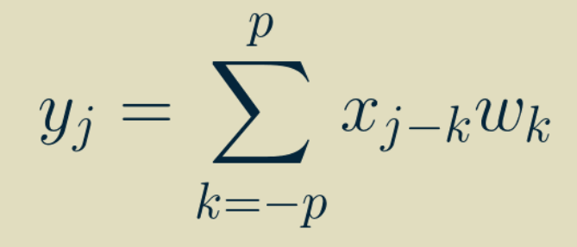
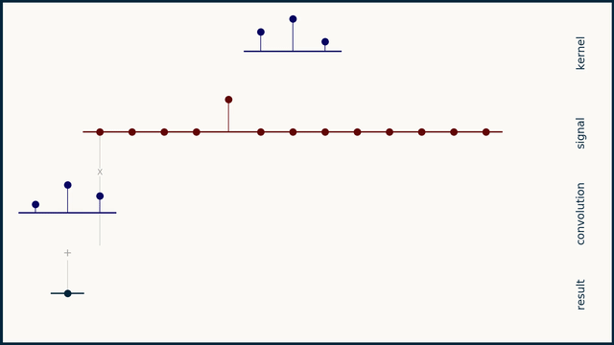
One-Dimensional Convolutional Neural Network (1D-CNN)
Output
Input
Weights
Simple & inexpensive
Source: Brandon Rohrer
Notes:
VOTE: How many weights in the first layer if we have to process two sequences of 10 steps? 20 steps?

Slide 14
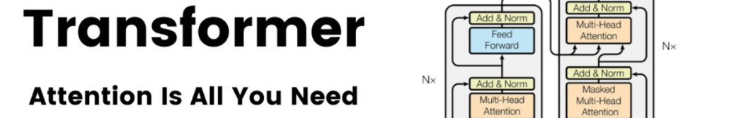
Min 30-35: Algorithms to process time series
Learning Objective 5 = Know at least three algorithms to process time-series
Vanilla RNN
LSTM
GRU
Transformers

Slide 15
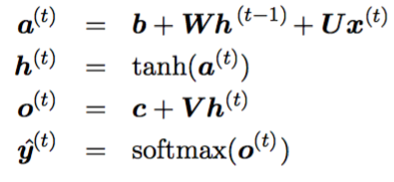
“Vanilla” Recurrent Neural Networks (RNNs)
Regularization Idea:
Use the same update rule (same weights W) to update the hidden state h(t) using inputs x(t) & h(t-1)
4
2
Source: Raimi Karim (Towards Data Science)
Notes:
Know at least three algorithms to process time-series
Unstable gradient problem = Decrease LR, use saturating activation fx, clip gradients, layer normalization, dropout
VOTE: How many weights in the first layer if we have to process two sequences of 10 steps? 20 steps?

Slide 16
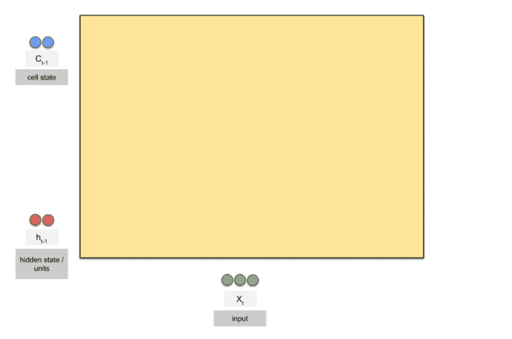
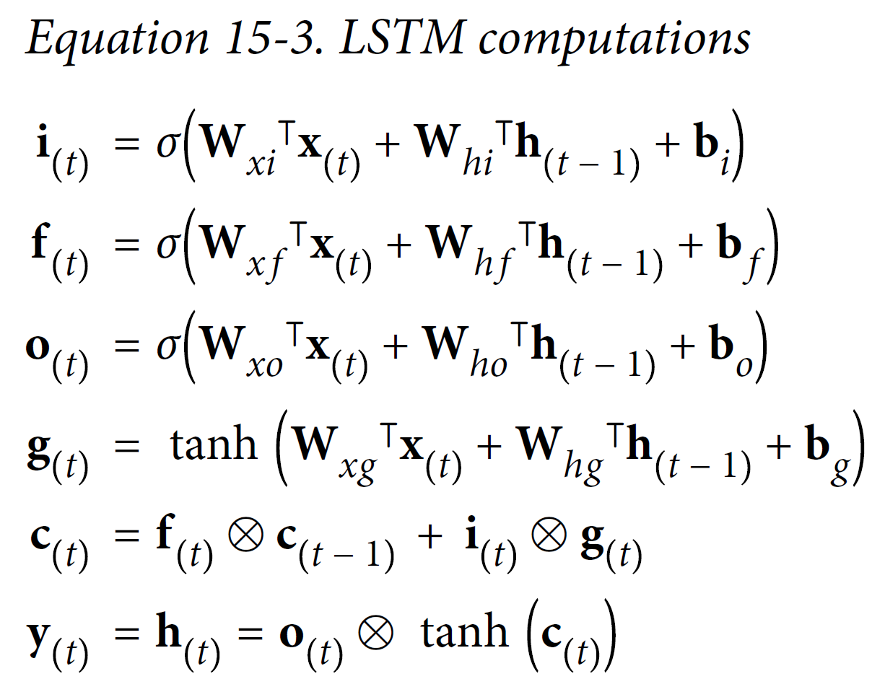
Long Short-Term Memories (LSTM)
Tackles the short-term memory problem by using long-term cell state c(t)
Source: Raimi Karim (Towards Data Science)
Notes:
Question: How the LSTM choose which information to keep, to remember and which information are not useful or irrelevant ? Question: How do LSTM cells recognize which information must be passed on to the long-term state?

Slide 17
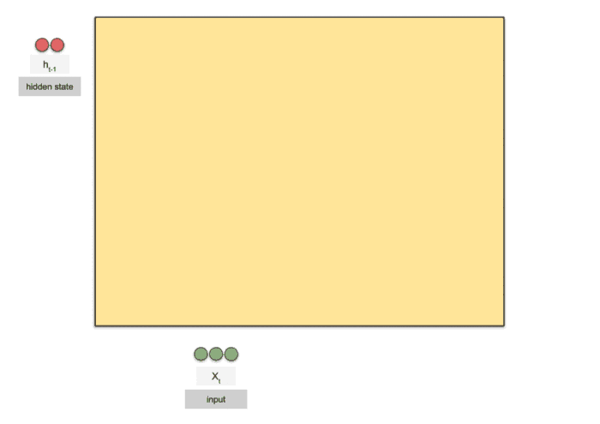
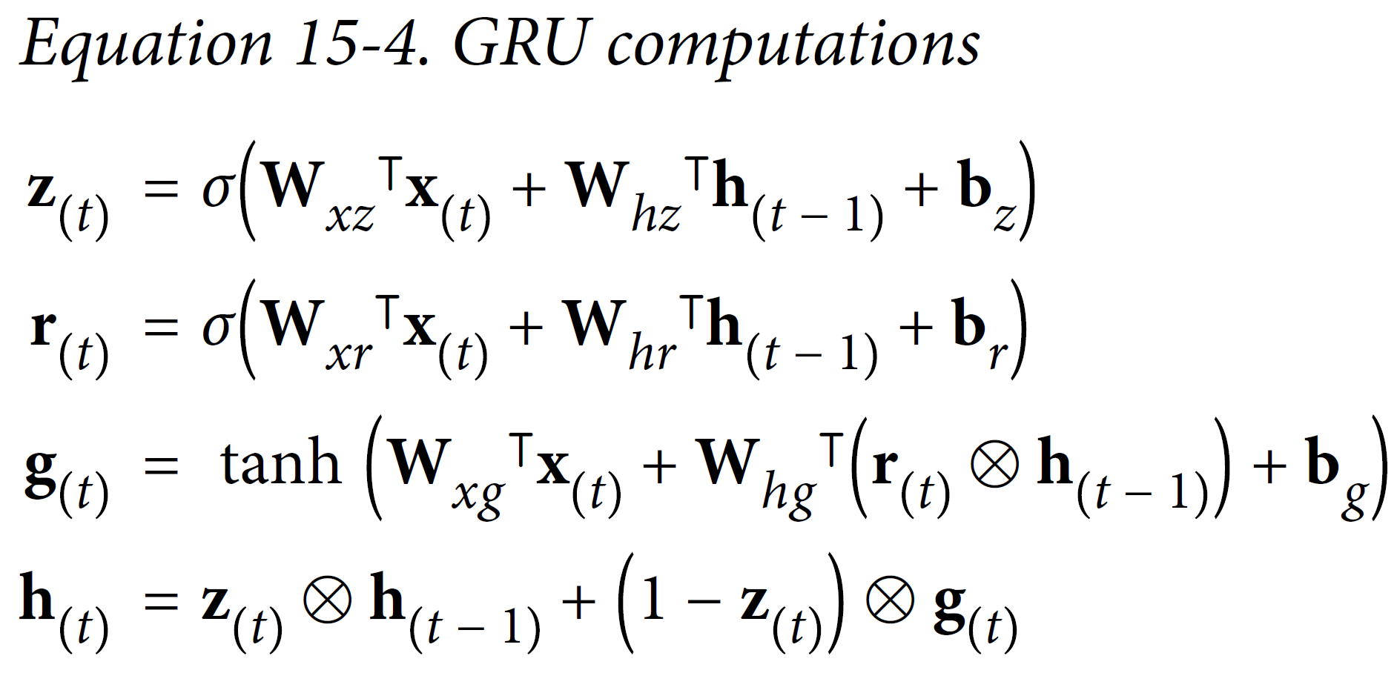
Gated Recurrent Units (GRU)
Simplifies the LSTM:
Single state vector h
Single gate controller z
No output gate, just r
Source: Raimi Karim (Towards Data Science)
Notes:
Question: How the LSTM choose which information to keep, to remember and which information are not useful or irrelevant ? Question: How do LSTM cells recognise what informations must be passed on to the long-term state?

Slide 18

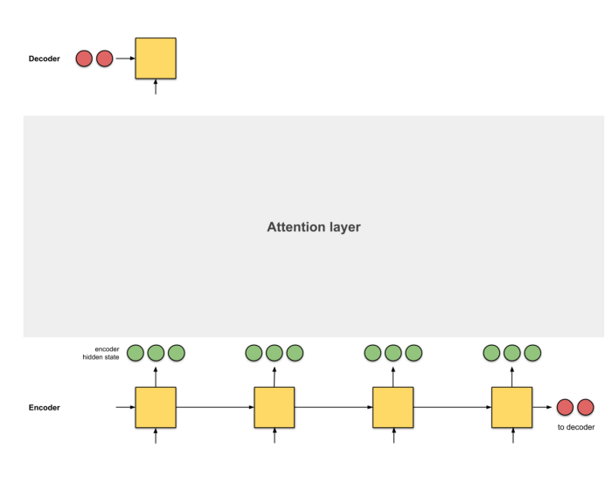
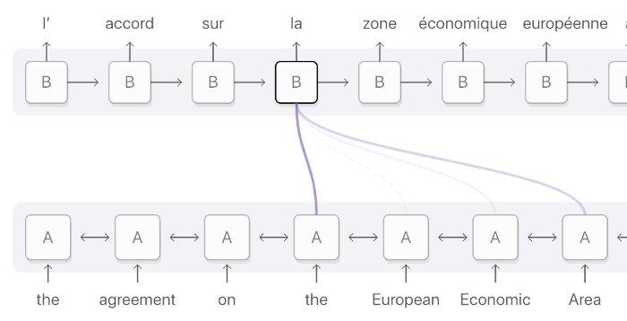
Attention = Interface between encoder & decoder to provide information about every hidden state
Attention layer = Alignment model
Source: Raimi Karim (Towards Data Science)
Notes:
VOTE: How many weights in the first layer if we have to process two sequences of 10 steps? 20 steps?

Slide 19

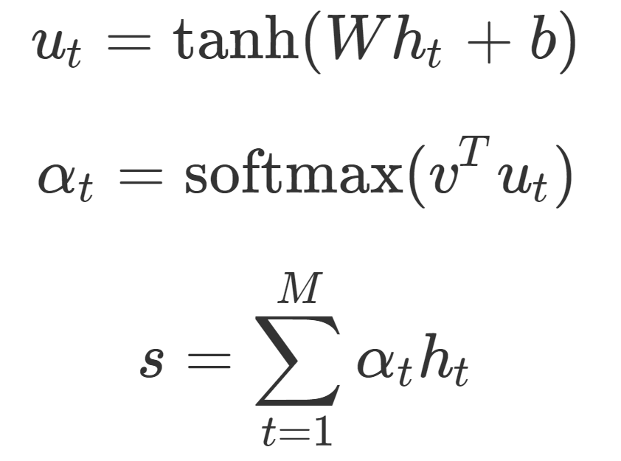
Step 0: Prepare hidden states
Source: Raimi Karim (Towards Data Science), Scott Rome

Slide 20
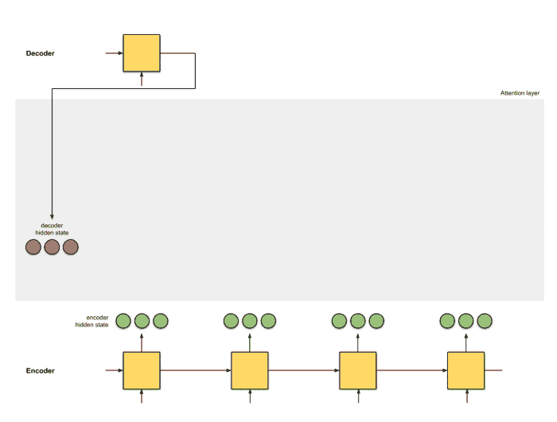
Step 1: Obtain score for every encoder hidden state
Source: Raimi Karim (Towards Data Science), Scott Rome
Notes:
Additive attention = tanh (Wh + W2 s) where s are past states
Multiplicative attention = h * W * s
Here, self attention

Slide 21
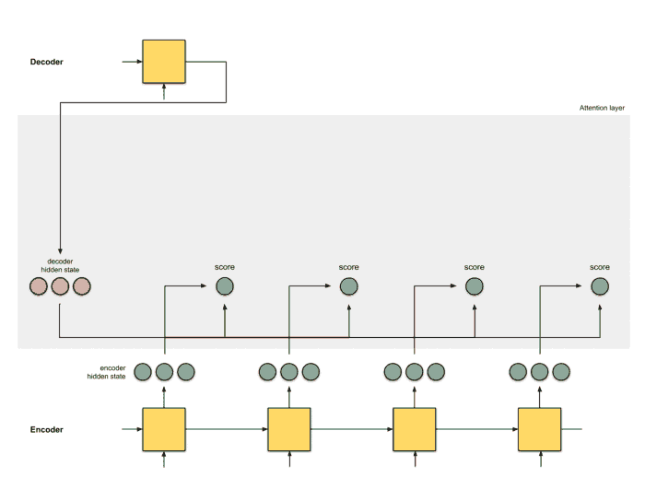
Step 2: Run all the scores through a softmax layer
Source: Raimi Karim (Towards Data Science), Scott Rome
Notes:
Question: How does the model know where to focus its attention ?

Slide 22

Step 3: (Encoder hidden states) x (Softmaxed score)
Source: Raimi Karim (Towards Data Science), Scott Rome

Slide 23
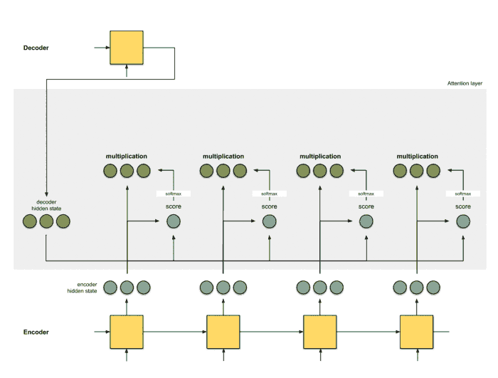
Step 4: Sum up the alignment vectors
Source: Raimi Karim (Towards Data Science), Scott Rome

Slide 24
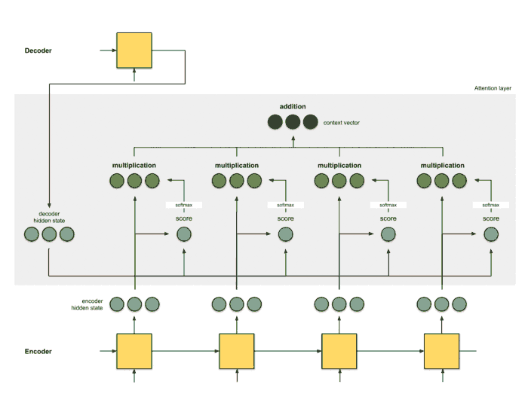
Step 5: Feed context vector into decoder
Source: Raimi Karim (Towards Data Science), Scott Rome

Slide 25
Attention = Interface between encoder & decoder to provide information about every hidden state
Attention layer = Alignment model
Source: Raimi Karim (Towards Data Science), Scott Rome

Slide 26
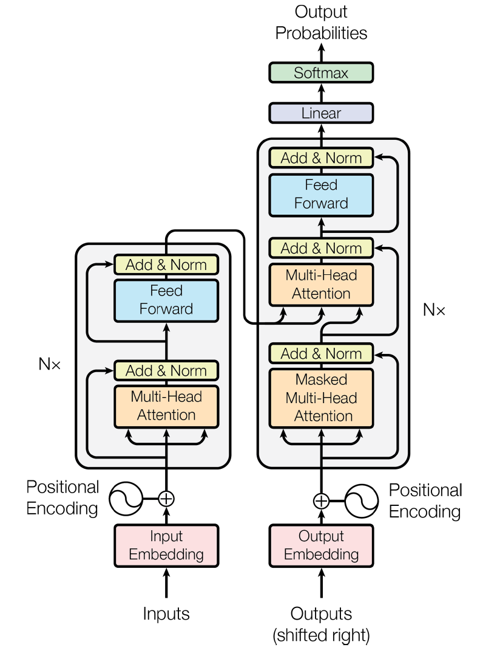
These attention (alignment) layers can be used to build the transformer architecture, revolutionizing NMT
Decoder
(stacked)
Encoder
(stacked)
Source: Géron, Fig 16-8
Notes:
The lefthand part is the encoder. Just like earlier, it takes as input a batch of sentences represented as sequences of word IDs (the input shape is [batch size, max input sentence length]), and it encodes each word into a 512-dimensional representation (so the encoder’s output shape is [batch size, max input sentence length, 512]). Note that the top part of the encoder is stacked N times (in the paper, N = 6).
The righthand part is the decoder. During training, it takes the target sentence as input (also represented as a sequence of word IDs), shifted one time step to the right (i.e., a start-of-sequence token is inserted at the beginning). It also receives the outputs of the encoder (i.e., the arrows coming from the left side). Note that the top part of the decoder is also stacked N times, and the encoder stack’s final outputs are fed to the decoder at each of these N levels. Just like earlier, the decoder outputs a probability for each possible next word, at each time step (its output shape is [batch size, max output sentence length, vocabulary length]).

Slide 27
1) Congratulations on excellent oral assessments ☺ 2) Thank you for your feedback on the course!
https://wp.unil.ch/dawn/files/2025/11/review_ml_ees_2025.pdf
No need to know all Géron, not the goal of the course
For each lectures, ~5 Learning Objectives (LOs)
Providing instructions at end of lecture for next week
Clarification on estimated workload

Slide 28
Workload distribution 5 ECTS ~10-15 Hours
Activity | Estimated Workload
Read Géron | 2-3 hours
Environmental Reading + Check out activities | 1-2 hours
Notebooks (↓) | 2-3 hours
Final Project (↑) | 2-3 hours
Class | 4 hours
TOTAL | 11-15 hours

Slide 29
Workload distribution 5 ECTS ~10-15 Hours
Activity | Estimated Workload | NEXT WEEK
Read Géron | 2-3 hours | Chapters 15,16
Environmental Reading + Check out activities | 1-2 hours | Kratzert et al. 2019
Notebooks | 2-3 hours | All Chapter 7 from e-book
Final Project | 2-3 hours | Work on presentation: (idea/task, methods, data)
Class | 4 hours | RNNs

Slide 30
Logistics for future evaluations
Note: Future oral assessments will be organized to avoid the delays we experienced last week.

Slide 31
Mid-term Presentations: Thursday, Nov 13 in GEO 2113 Office hours to prepare presentations: Oct 30th & Nov 5th
4min presentations + 6min Q&A/feedback
Tip = 1 slide/minute
Scientific question: What’s our goal and why do we care?
Dataset: Characteristics, challenges, training/validation/test split, etc.
Methodology: Which ML algorithm(s) are you planning to use and why?
Results: What are your initial results & what do you plan to do next?

Slide 32
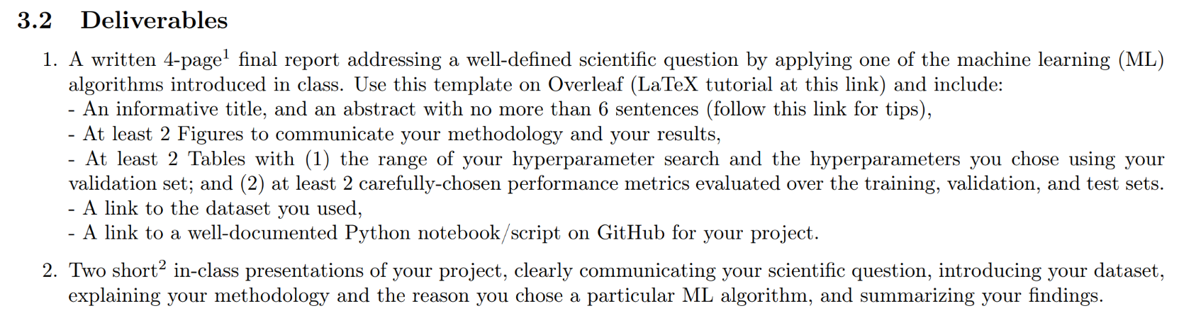
In-class Peer Review: Wednesday, Dec 10th, 12-2PM
Submit first draft of your project by December 9th

Slide 33
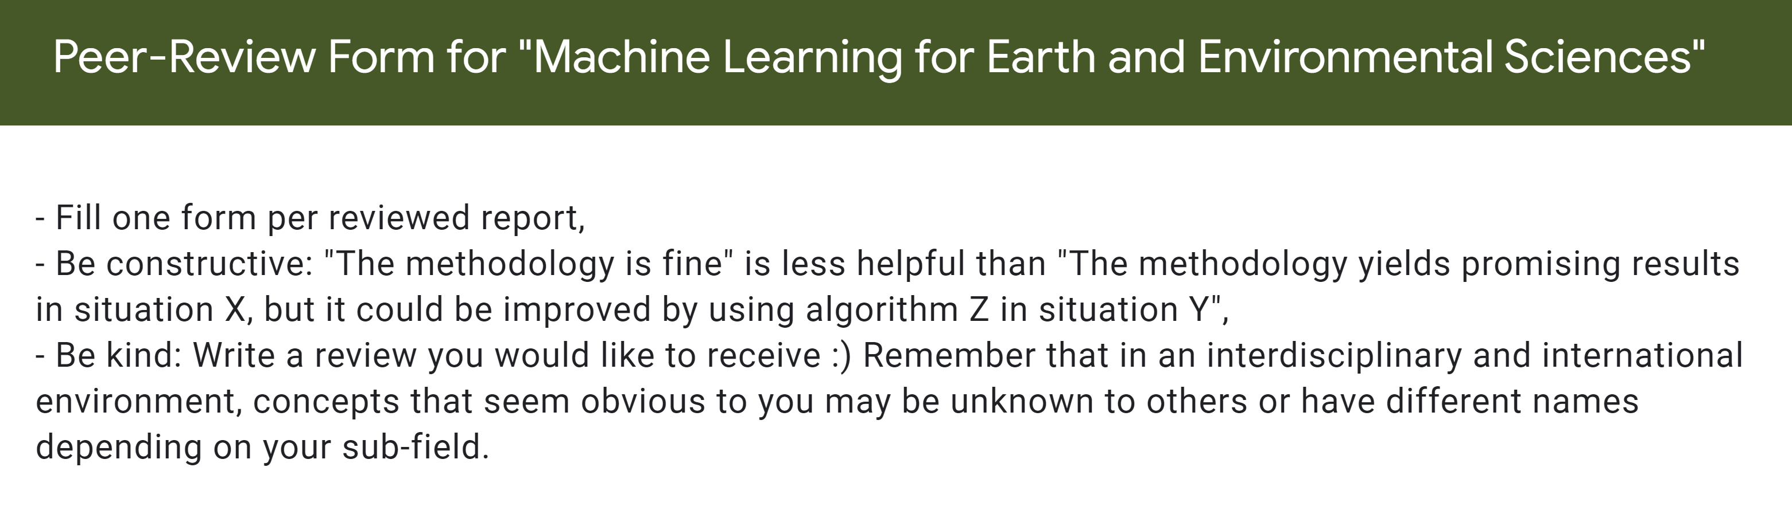

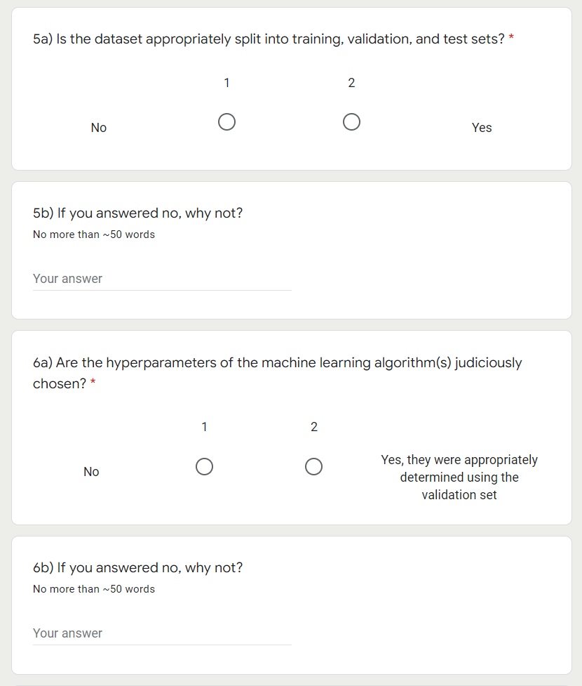

Slide 34
Final Presentations on Dec 11 & Dec 18 Registration sheet coming soon on Moodle
8min presentations + 2min Q&A
Tip = 1-2 slides for each of the following categories:
Scientific question: What’s our goal and why do we care?
Dataset: Characteristics, challenges, training/validation/test split, etc.
Methodology: Which ML algorithm(s) did you choose and why?
Results: What are your findings and how does it answer the sci. question?

Slide 35

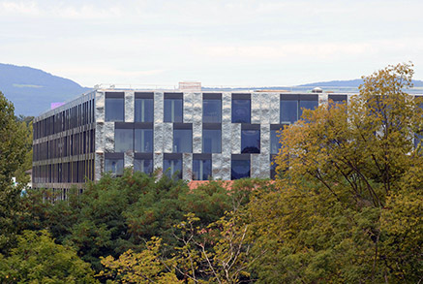
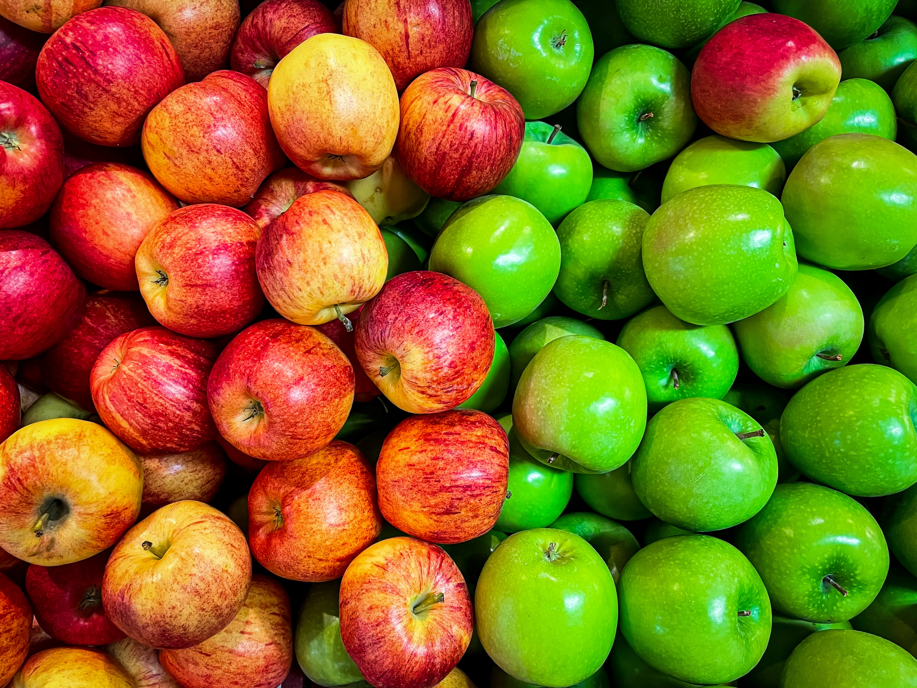
Min 105-120: Break

Slide 36
Legacy slides: Graph Neural Networks

Slide 37
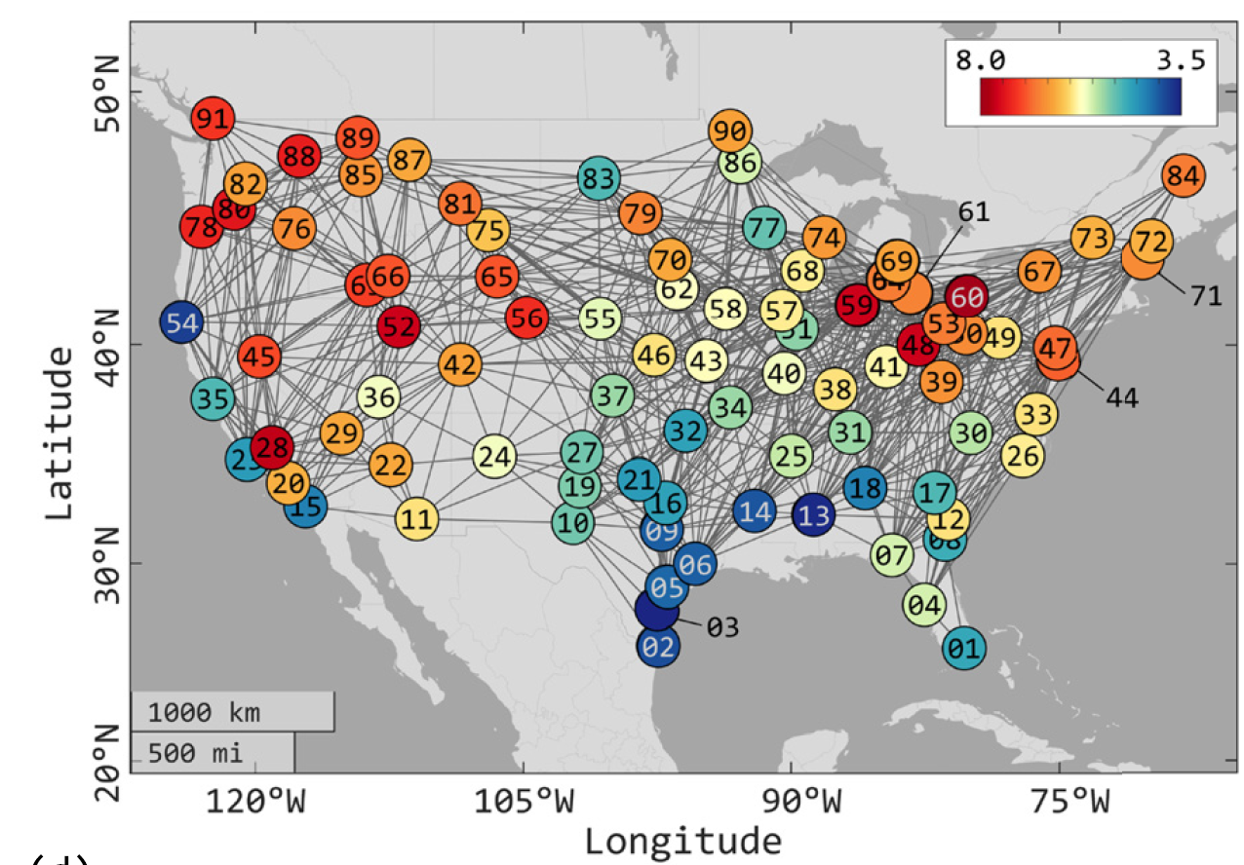

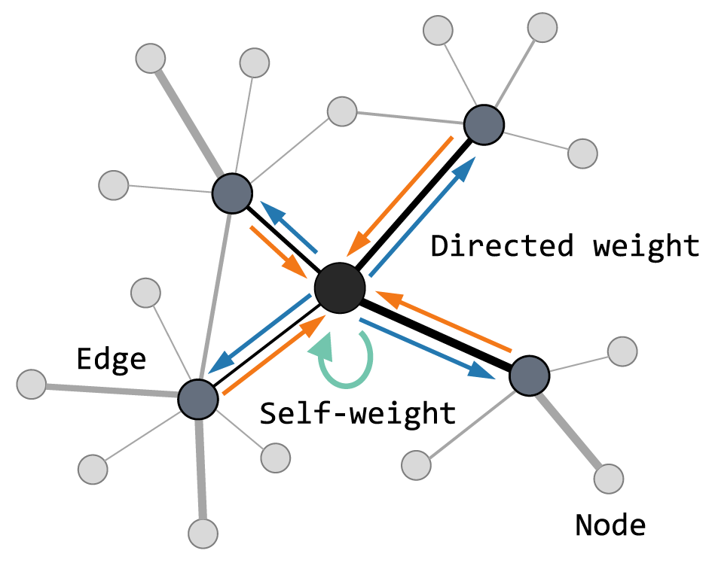
How to make accurate predictions on unstructured meshes?
?
Source: Li et al. (2023)

Slide 38
Min 35-55: Graph Neural Networks for predictions on unstructured meshes
Learning Objectives (Labonne Ch. 1+2; Wu et al. 2019):
Define a graph
Identify applications where graph neural networks are effective
Describe at least three algorithms for making predictions on graphs

Slide 39
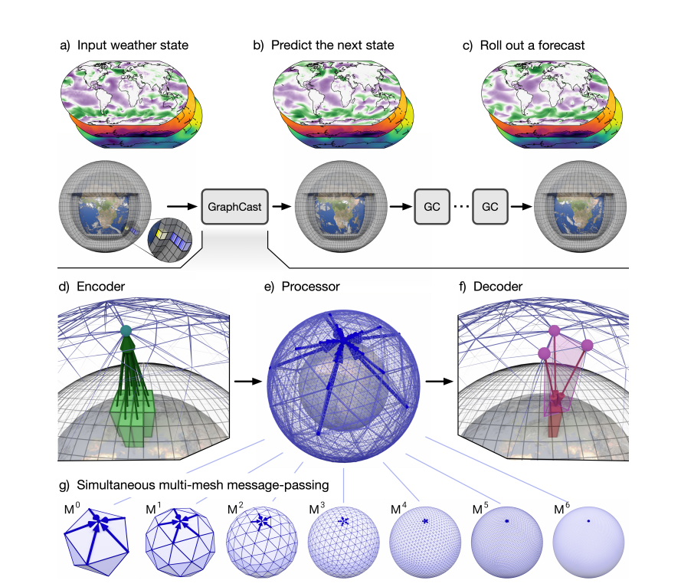
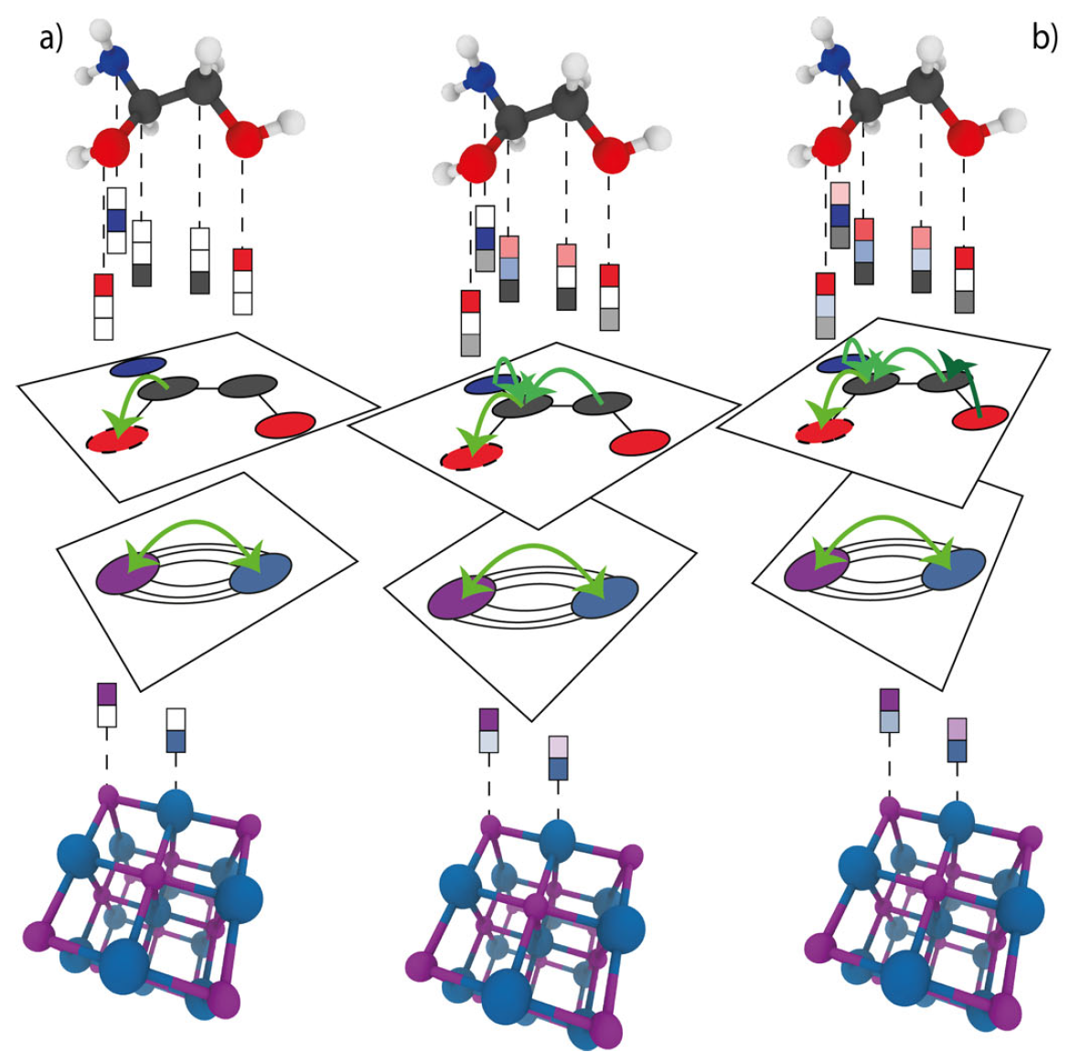
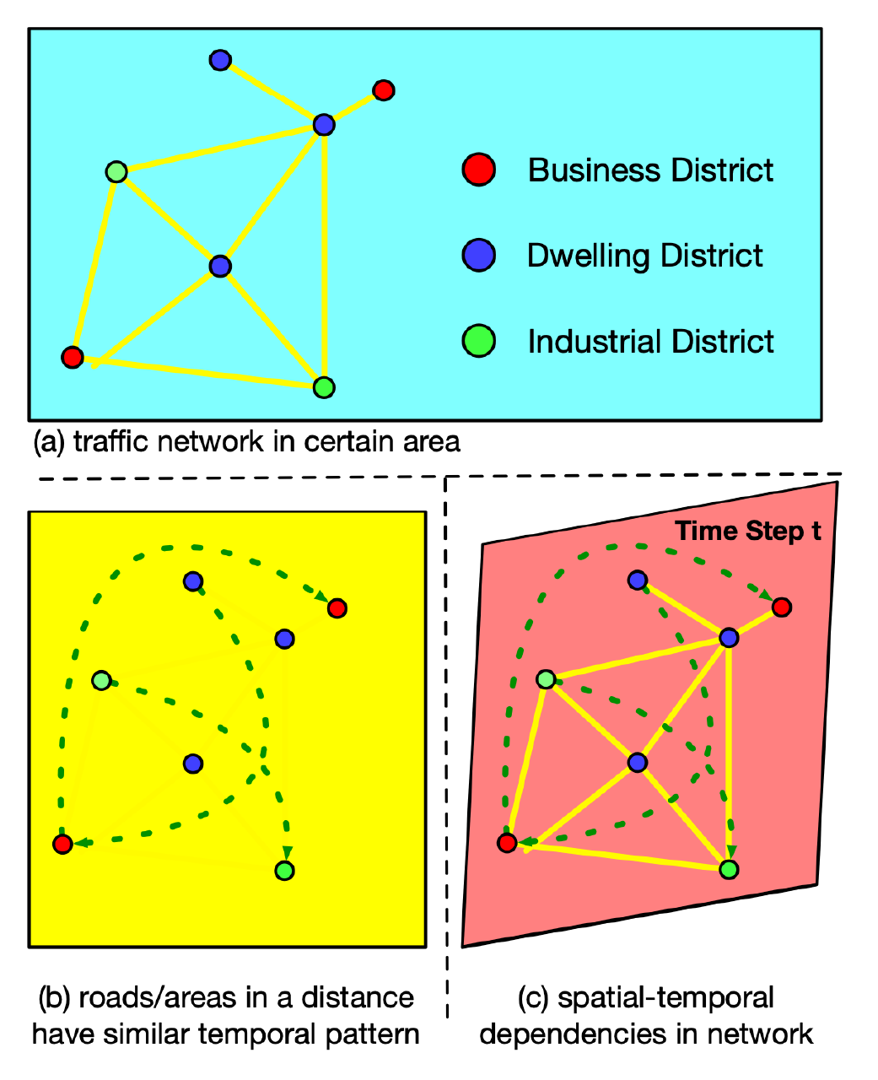
GNNs have led to breakthroughs in scientific ML Lam et al. (2023); Reiser et al. (2022); Li et al. (2021)

Slide 40
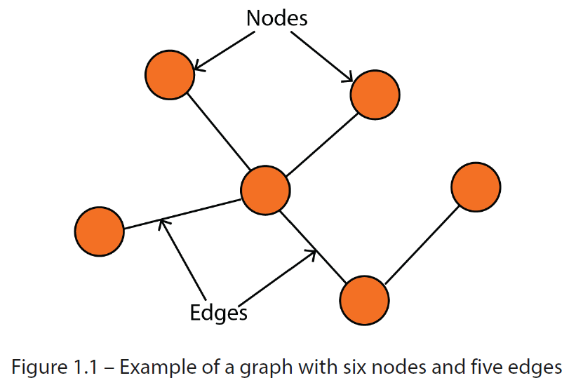
Graph = Nodes (Vertices) + Edges
Source: Labonne (Ch1)
Notes:
Graph = collection of nodes and edges

Slide 41
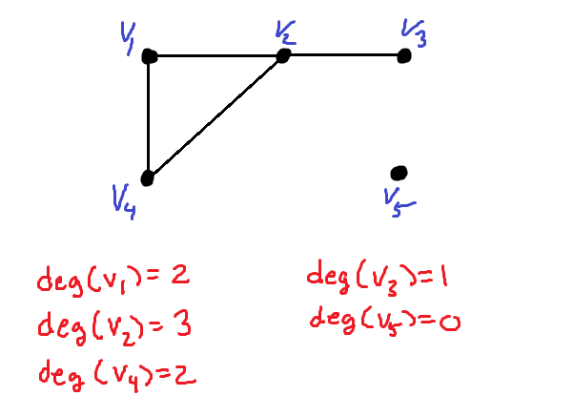
Graph = Nodes (Vertices) + Edges Degree of a node v = Number of edges incident to v
Source: Labonne (Ch1)
Notes:
Graph = collection of nodes and edges. Nodes represent entities and edges represent relationships.

Slide 42
Graph = Nodes (Vertices) + Edges Degree of a node v = Number of edges incident to v Adjacency matrix = 1 if nodes are connected, 0 otherwise
 | 1 | 2 | 3 | 4 | 5 | 6
1
2
3
4
5
6
1
2
3
6
4
5
Source: Labonne (Ch1)
Notes:
Graph = collection of nodes and edges. Nodes represent entities and edges represent relationships.

Slide 43
Graph = Nodes (Vertices) + Edges Degree of a node v = Number of edges incident to v Adjacency matrix = 1 if nodes are connected, 0 otherwise
 | 1 | 2 | 3 | 4 | 5 | 6
1 |  |  | 1
2 |  |  | 1
3 | 1 | 1 |  | 1 | 1
4 |  |  | 1
5 |  |  | 1 |  |  | 1
6 |  |  |  |  | 1
1
2
3
6
4
5
Source: Labonne (Ch1)
Notes:
Graph = collection of nodes and edges. Nodes represent entities and edges represent relationships.

Slide 44
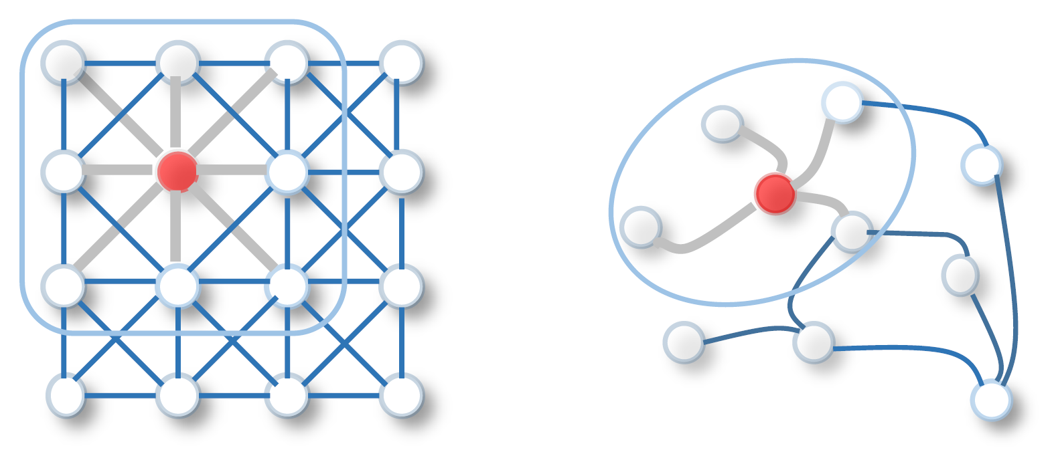
Graphs are well-suited for inter-connected systems & unstructured meshes
Source: Wu et al. (2019)

Slide 45
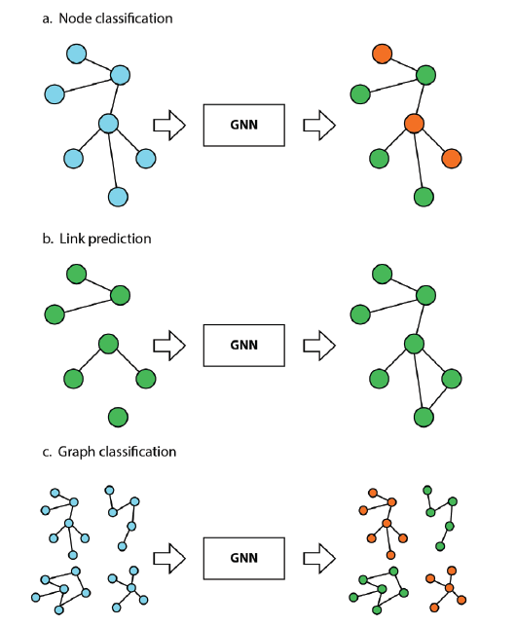
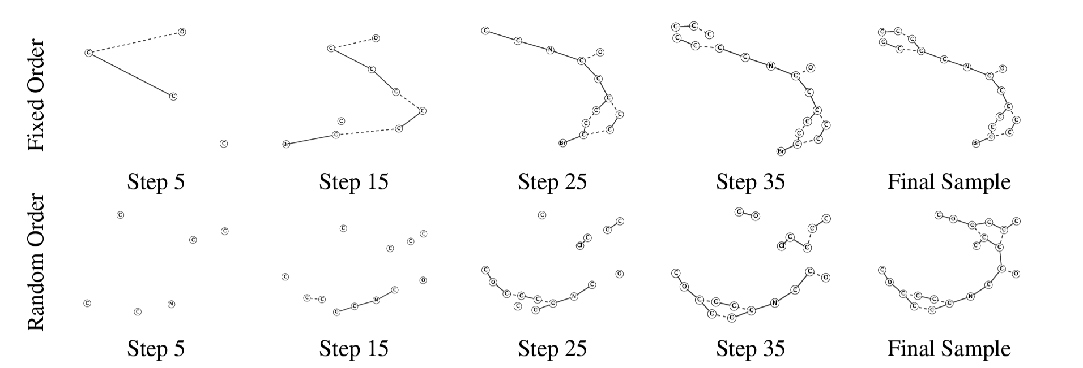
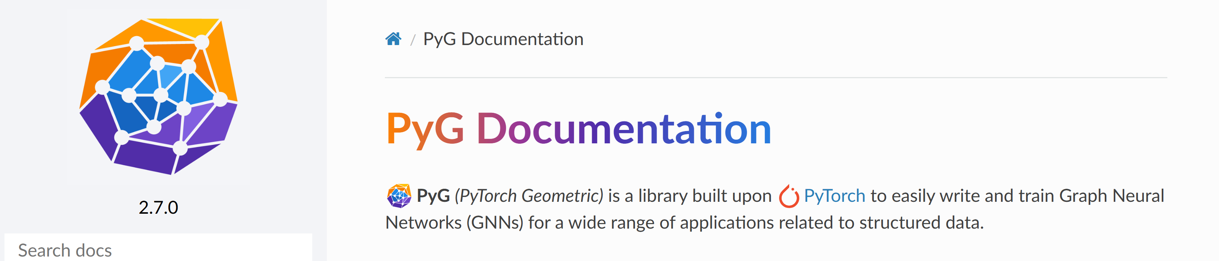
What kind of tasks can Graph NNs solve? Node & Edge-level prediction, graph classification & generation
PyTorch Geometric
Source: Labonne (2023); Li et al. (2018)
Notes:
+ Graph generation

Slide 46
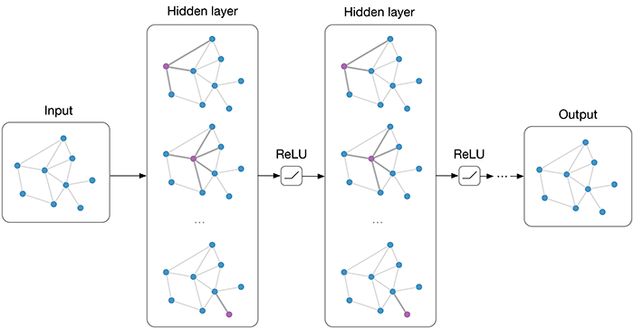

Node embedding = Learn suitable representation of node features Message passing = Information exchange between node and its neighbors
1) Graph Convolutional Networks (GCNs)
Normalization by degree
Source: Thomas Kipf (2016)
Implementation: Labonne Ch. 6

Slide 47


What if some neighboring nodes are much more important than others?
2) Graph Attention Networks (GATs)
Normalized attention weights:
Source: Velickovi et al. (2018) Implementation: Labonne Ch. 7

Slide 48


What if the graph structure is not known ahead of time?
3) GraphSAGE samples a fixed-size neighborhood and aggregates their information
Source: Khemani et al. (2018) Implementation: Labonne Ch. 8

Slide 49
Legacy slides

Slide 50


Introduction to Natural Language Processing (NLP) = Programming CPUs to Analyze Natural Language Data
Chopping the dataset into multiple windows to predict sequence shifts
Stateful RNN: Remembering the previous sequence to predict the next
Requires non-overlapping sequence
Chopping the dataset into multiple windows to predict sequence shifts
Notes:
NLP is a subfield of linguistics, computer science, and artificial intelligence concerned with the interactions between computers and human language, in particular how to program computers to process and analyze large amounts of natural language data. (Wikipedia)
Batching is harder, but it is not impossible. For example, we could chop Shakespeare’s
text into 32 texts of equal length, create one dataset of consecutive input sequences
for each of them, and finally use tf.data.Dataset.zip(datasets).map(lambda
*windows: tf.stack(windows)) to create proper consecutive batches, where the nth
input sequence in a batch starts off exactly where the nth input sequence ended in the
previous batch (see the notebook for the full code).

Slide 51


Encoding Categorical Features using Embeddings
Simpler alternative to one-hot encoding with user-chosen (# of dimensions)
Will gradually improve during training
Source: Géron (Ch13)

Slide 52


Machine Translation Models
Training the model
Using the model (inference time)
Source: Géron (Ch16)
Notes:
At each step, the decoder outputs a score for each word in the output vocabulary (i.e., French), and then the softmax layer turns these scores into probabilities. For example,
at the first step the word “Je” may have a probability of 20%, “Tu” may have a probability of 1%, and so on. The word with the highest probability is output. This is
very much like a regular classification task, so you can train the model using the "sparse_categorical_crossentropy" loss, much like we did in the Char-RNN model.
Note that at inference time (after training), you will not have the target sentence to feed to the decoder. Instead, simply feed the decoder the word that it output at the
previous step, as shown in Figure 16-4 (this will require an embedding lookup that is not shown in the diagram).

